Slide 1


REAL-TIME GAME DEVELOPMENT WITH TI LAUNCHPAD
Name – AYUSH MISHRA
Roll No.- 1805231016
Branch – Electronics & Communication Engineering (3rd year)
Under the supervision of :
Prof. Kavi Arya, Department of C.S.E. , IIT Bombay
E-Yantra Summer Internship Program
Duration : 7 weeks

Slide 2
Objective :
The prime motive of this project is to design and develop a Real-time game using TI-RTOS kernel with Texas Instruments (TI) MSP430 launchpad.

Slide 3
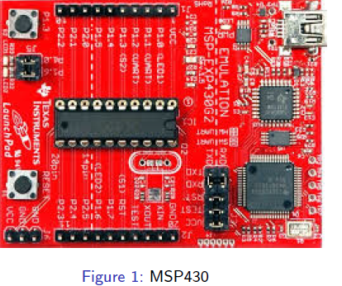
Launchpad Used :

Slide 4
Port Configuration of MSP430 :
Name | Pins | Function
GPIO pins | P1.0 to P1.7 & P2.0 to P2.5 | These are the input/output pins of the microcontroller given out of the board for interfacing.
Button | P1.3 | Can be used for general purpose interfacing during operation.
LEDs | P1.0 & P1.6 | Can be used for general purpose indication during operation.
Reset | Connected to RESET pin of microcontroller | If pressed the microcontroller will reset.
Programming port | USB connector at the top | The device will be connected to PC (For programming and power) using this port.

Slide 5
GPIO Interfacing
GPIO Registers in MSP430 –
PxDIR
PxOUT
PxIN
PxREN
PxSEL & PxSEL2
Interfacing LEDs and Buzzers
Interfacing switches

Slide 6
Timers and PWM
The MSP430G2253 has two 16 bit timers, Timer0 and Timer1 both are Timer_A variants with three capture/compare registers. The MSP430 family guide lists two types of 16 bit timer, Timer_A and Timer_B.
The basic functions of timers are to provide delay, can act as counter and also it can control compare capture mode.
To control and vary the speed of DC Motors during motion and control the angle of Servo Motors, we use concept of PWM.

Slide 7
Motion control & Variable speed control using PWM
PWM Signal is a digital signal set High and Low in a predefined time and speed. The time during which the signal stays high is called the “on time” and the time during which the signal stays low is called the “off time”.
To control and vary the speed of DC Motors during motion and control the angle of Servo Motors, we use concept of PWM.

Slide 8
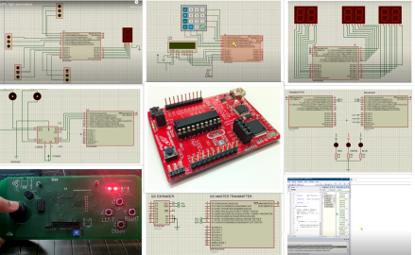
Snapshots of Circuits designed on Proteus and Video demonstrations
Snapshots
Compiled Proteus simulation for few experiments.

Slide 9
Ti-RTOS
TI-RTOS is an embedded tools ecosystem created and offered by Texas Instruments (TI) for use in a wide range of their embedded processors.
It includes a real time operating system component called "TI-RTOS Kernel" (formerly known as "SYS/BIOS”) along with additional components that support device drivers, networking connectivity stacks, power management, file systems, instrumentation, and inter-processor communications.
TI-RTOS provides a wide range of application such as multitasking, memory management and real-time analysis. Because TI-RTOS can be used in such a wide variety of different microprocessors with very different processing and memory constraints, it was designed to be highly configurable.

Slide 10
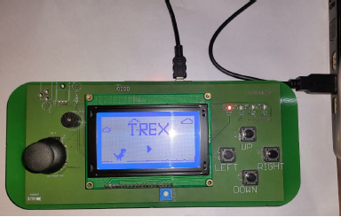
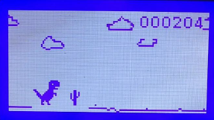
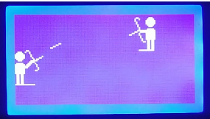
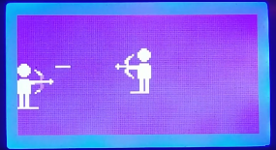
Capstone Project
Two games were designed –
T-Rex Game
HawkEye Game

Slide 11
Hardware used :
MSP-EXP430F5529LP
Graphical LCD
Gaming console
Software used :
IAR Embedded Workbench for MSP430
Proteus 8.1 professional
Code Composer Studio 6.1.3
Ti-RTOS
GLCD Font creator

Slide 12
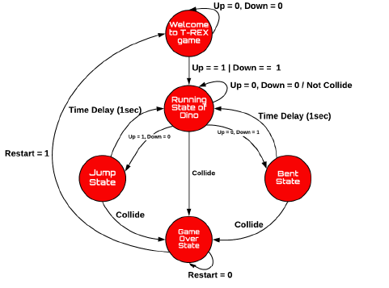
State Chart of T-Rex

Slide 13
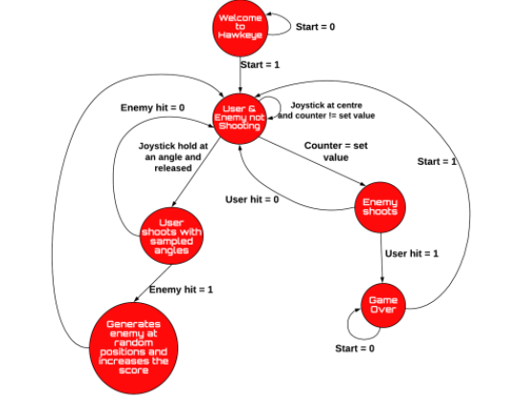
State Chart of HawkEye

Slide 14


